Slide 1



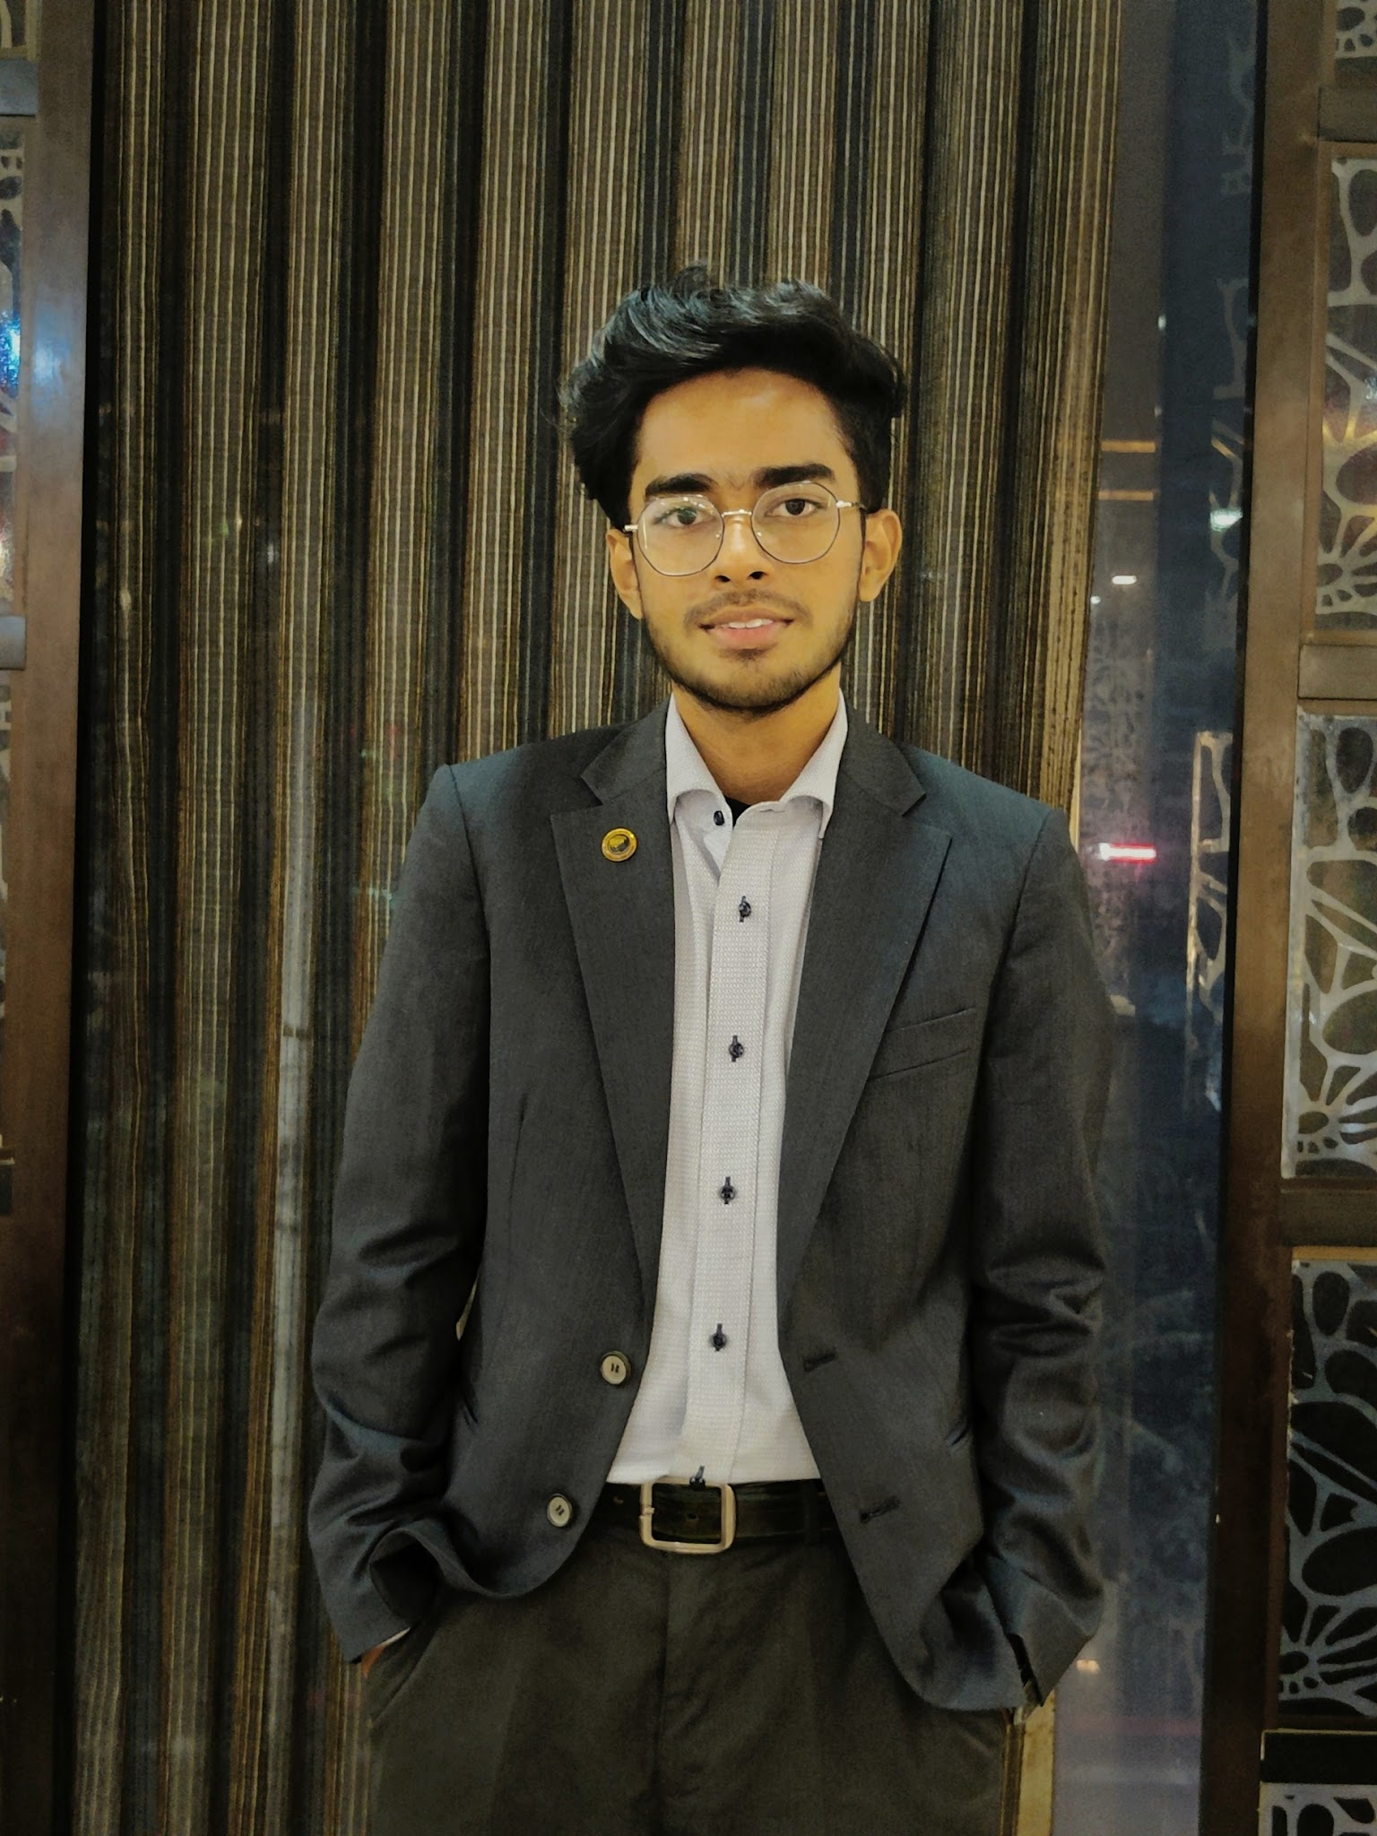




Senior Design
SummaryScribe
Transformative Meeting Summarization using Prompt Engineering with Retrieval Augmented Generation (RAG) Technique Based on Natural Language Processing
Group Members
Md Saiyem Raiyan
2012468042
Sheikh Mohammed Wali Ullah 2021186042
Zobaer Ahammod Zamil
2021796042
Samia Sultana
2014048042

Slide 2
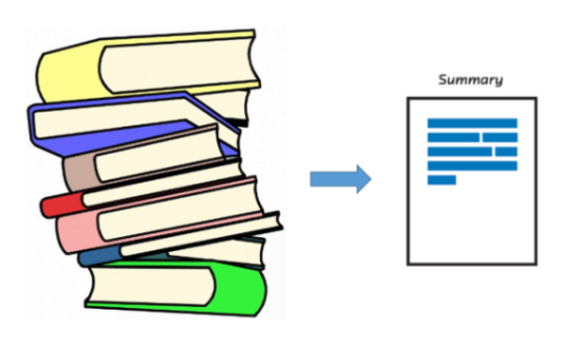
What’s the project?
Summarize a long meeting so that we can be able to understand easily and in a faster way within our due time. Therefore, a gist of an online meeting is often very important to those who missed it or those who try to recall it. There can be a system that can make a summary of a meeting while it is running online.
What NLP Doing?
System Ability
Generated Summary
Summarizing develops a system that can automatically generate accurate and informative summaries of meetings.
Identify the most important topics, extract key points, decisions, action items, discussions, and present them in a coherent and concise manner.
Crafts comprehensive summaries of online meetings as they unfold. Capture the essence of the meeting while filtering out redundant or less relevant information.

Slide 3
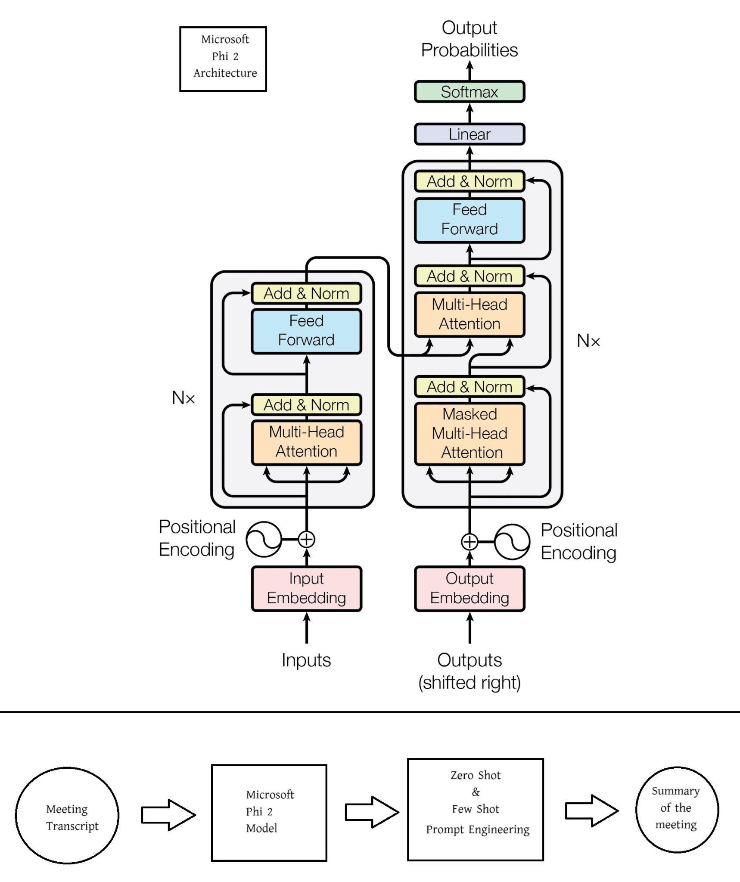

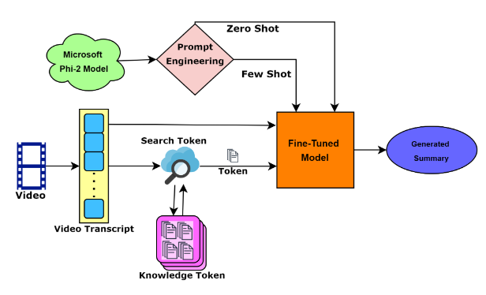
Analysis of Design
Phi-2
Prompt Engineering
Phi-2
Zero Shot
Few Shot
RAG

Slide 4
Usability, Manufacturability, Sustainability
Resource Efficiency and Long-term Impact
Educational Outreach (educational resources, training programs, and workshops)
Long-Term Vision
Usability
Manufacturability
Sustainability
Integration with Other Tools
Efficiency (review, note-taking )
Accuracy (precision, recall, F1 score)
Integration (Workflows, software tools)
Accessibility
Software or API (User friendly, prompts, tooltips, and visual cues)
Integration with Existing Tools
User-Centric Design
Scalability and Reliability
Training and Support

Slide 5
Implementation
40%
30%
30%
Zero Shot
Generate text and better summary from
Large Language Model (LLM)
Phi-2
Few Shot
RAG
Improve the generated summary
RAG Technique
Zero Shot
Few Shot

Slide 6
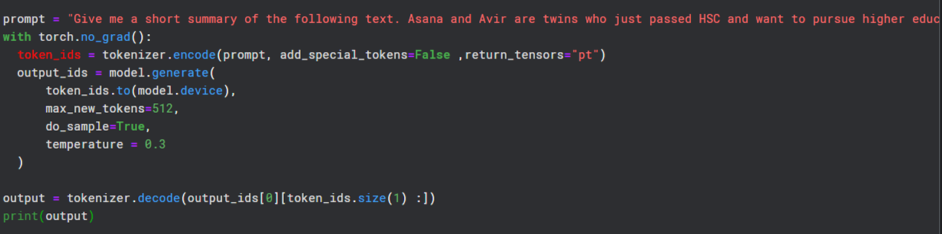
Implementation
Pipeline functions set up as a text generation
STAGE 1
Generate text summary based on provided prompt
STAGE 2
Initialize tokenizer as a casual language Model
STAGE 3
Utilize the tokenizer to encode the prompt
STAGE 4
Summary

Slide 7
Development Process
Prompt Engineering
(Zero Shot, Few Shot,
RAG Technique)
Mamba
Zephyr
EleutherAI/
gpt-neo-2.7B
Pegasus
Microsoft Phi-2
Hyperparameter
Tuning
Prompt Engineering

Slide 8
Environmental Considerations & Sustainability
Carbon footprint
Server Infrastructure, Video Streaming, Softcopy, Internet Connectivity
Power consumption
Data Transmission, Electricity, User Devices
Energy Efficiency
Reduced Environmental Impact, Internet and Electricity, Cost Savings
Paper & Ink usage
Saving trees and minimizing deforestation
GPU power-saving issue

Slide 9
Tools and Technology Used
Tool | Functions | Other Similar Tools | Selection Reasons
Kaggle | Coding implementation | Jupyter Notebook, colab | Lake of GPU in local device 2x 15 GB T4 GPU
Hugging Face | Model & Dataset Collection | Kaggle | Easy to select based on our requirements
ChatGPT | Compare summaries, bug fixing support | StackOverflow | To debug & compare outputs
Happy Transformer | Library for Python |  | Open-source and offers a complete set of tools and pre-trained models for dealing with a variety of NLP applications
Google Pegasus | Model used to train and generate summary
EleutherAI/gpt-neo/2.7B | Model used to Fine-tune and generate summary |  | Previously selected PEGASUS model didn’t work
Microsoft/phi-2 | Model Used to generate summary using zero shot and few shot |  | Previously selected model couldn’t generate a proper summary of meeting script
Prompt Engineering | Using RAG Technique |  | Improve the generated Summary

Slide 10
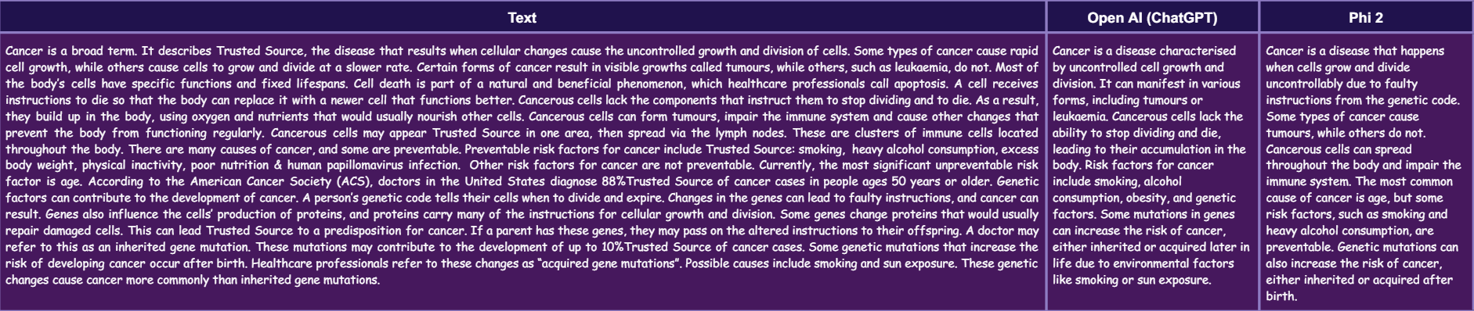
Results
 | BLEU Score | ROUGE Score | Comparison
Zero Shot | Average Bleu Score: 0.05839642613318564 | Average ROUGE Scores: rouge-1: 0.46706586348309376 rouge-2: 0.12499999538305183 rouge-l: 0.4071856239621356 | Grammarly: Hemingway: Length:
Few Shot | Average Bleu Score: 0.06868253918426882 | Average ROUGE Scores: rouge-1: 0.38260869101550093 rouge-2: 0.13157894295360126 rouge-l: 0.3478260823198488
OpenAI : 11 (OK)
Phi-2: 10 (Good)
OpenAI : 95/100
Phi-2: 100/100
Main Text: 417 words
Phi-2 Reduced: 78 words
81% Reduced

Slide 11
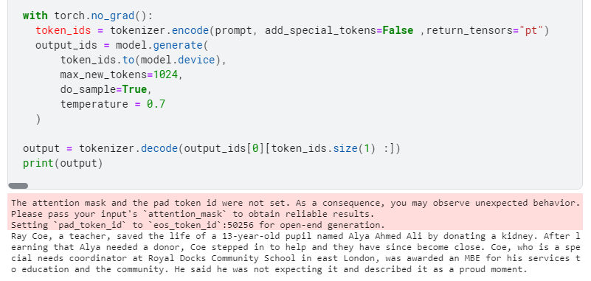
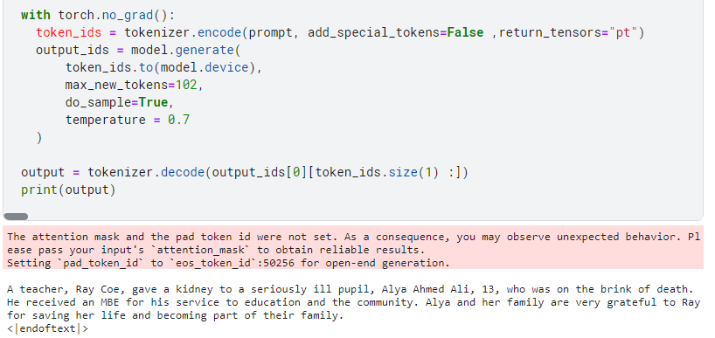
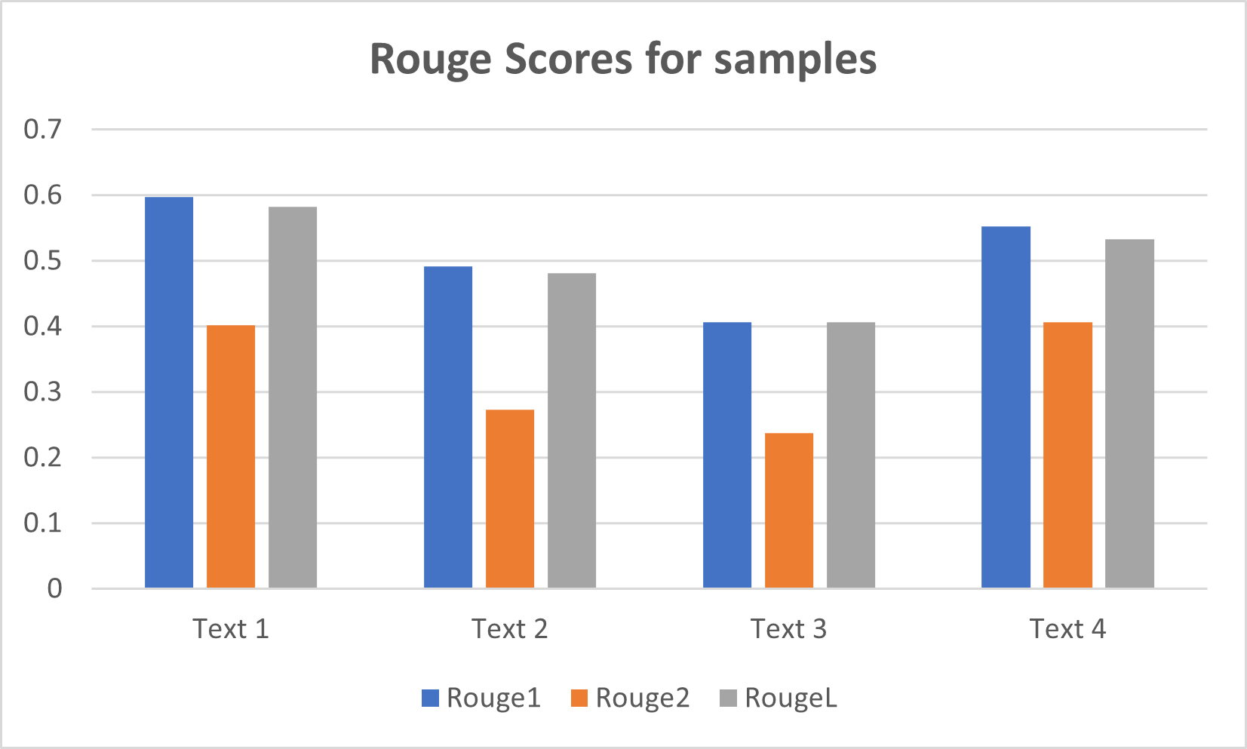
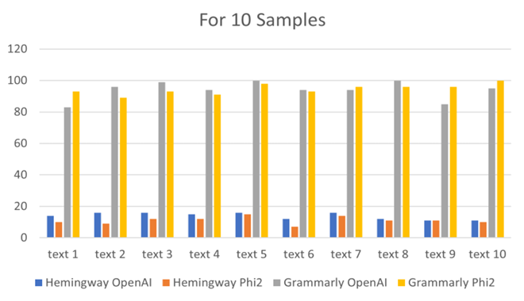
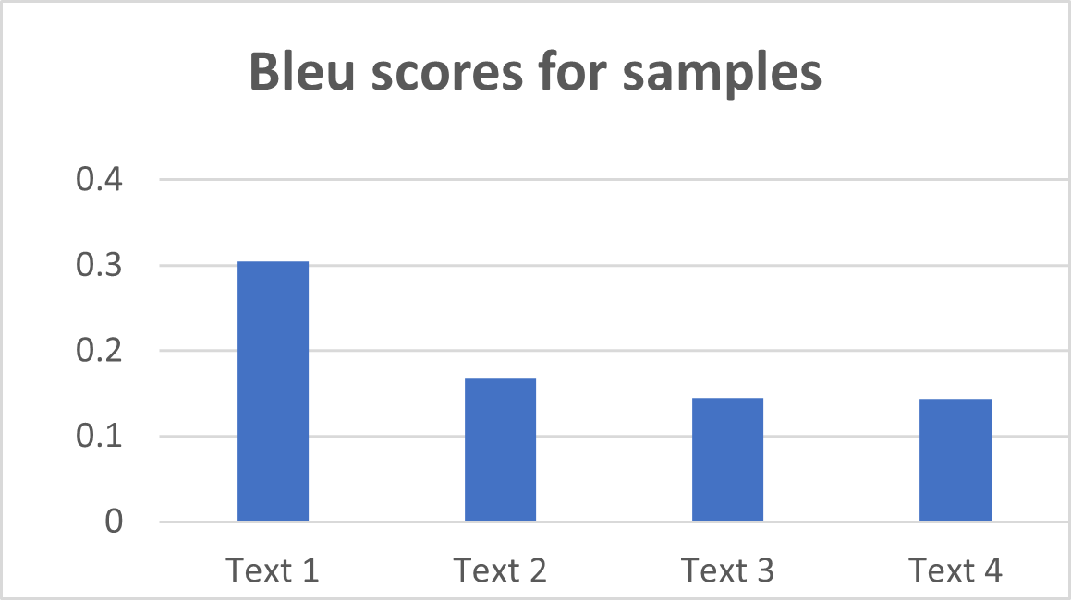
Results
Zero Shot
Few Shot
We evaluated the accuracy of the generated summary using Rouge and Bleu scores. Since we did not have the actual ground truth of the texts, we relied on the Hemingway score and Grammarly readability score to assess the generated texts from the Microsoft Phi-2 model and the OpenAI ChatGPT. Upon analysis, we found that the scores for the summaries generated from the Phi-2 model and ChatGPT are quite similar. This indicates we can achieve a proper contextual summary using a low-resource model like Microsoft Phi 2.
Just using the prompt engineering technique we got a good result compared to the openAI summary. Shown above with BLEU and ROUGE scores. So, if we can fine-tune the model with resources we may get a more contextual summary with semantics

Slide 12

THANKS!

